Slide 1
BA Training Day 7

Slide 2

Review of Day 5
Gap Analysis
STLC
Test Cases
Defect Management

Slide 3
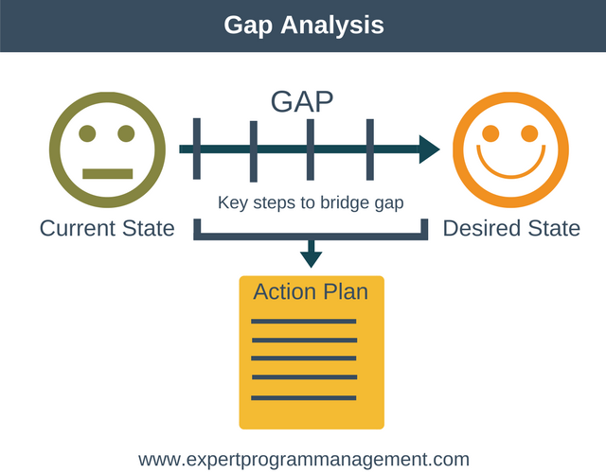
Gap Analysis
A technique that businesses use to determine what steps need to be taken in order to move from its current state to its desired, future state.
Gap analysis consists of:
(1) listing of characteristic factors (such as attributes, competencies, performance levels) of the present situation ("what is"),
(2) listing factors needed to achieve future objectives ("what should be"), and then (3) highlighting the gaps that exist and need to be filled.
A company will list the factors that define its current state, outline the factors that are required to reach the target state, and then determine how to fill the "gaps" between the two states.

Slide 4
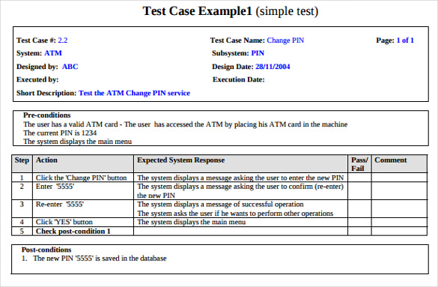
Test Case
A Test Case is a document that describes step by step process how to test the application.
A Test Case includes Test Case ID, Steps Description, Expected Output, Actual Output, Pass/Fail, Remarks.

Slide 5
Types of Test Cases
Unit testing:
Shakeout testing
Smoke testing
Functional testing
Integration testing
Regression testing
System testing
Load testing
Stress testing
Performance testing
User acceptance testing
Black box testing
White box testing
Alpha testing
Beta testing

Slide 6
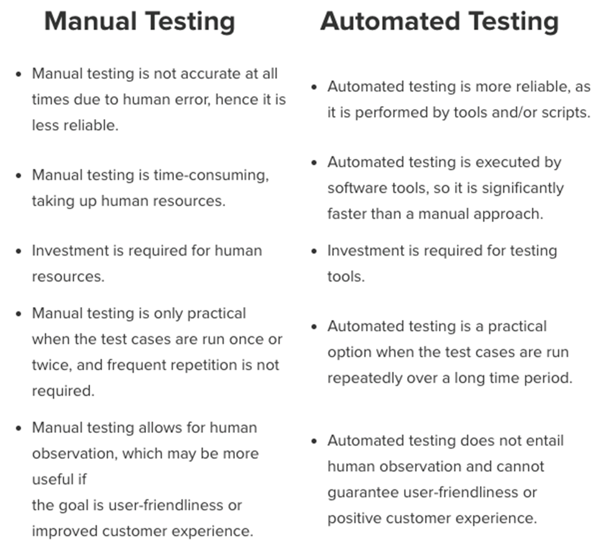
Manual Vs Automated

Slide 7
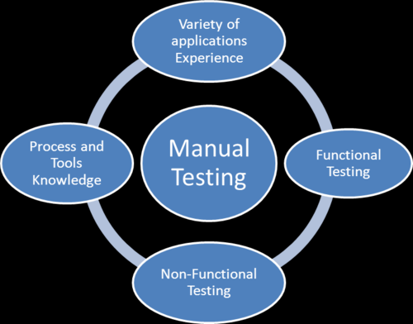
Manual Testing
In short, manual testing is best suited to the following areas/scenarios:
Exploratory Testing: This type of testing requires the tester’s knowledge, experience, analytical/logical skills, creativity, and intuition. The test is characterized here by poorly written specification documentation, and/or a short time for execution. We need the human skills to execute the testing process in this scenario.
Usability Testing: This is an area in which you need to measure how user-friendly, efficient, or convenient the software or product is for the end users. Here, human observation is the most important factor, so a manual approach is preferable.
Ad-hoc Testing: In this scenario, there is no specific approach. It is a totally unplanned method of testing where the understanding and insight of the tester is the only important factor.

Slide 8
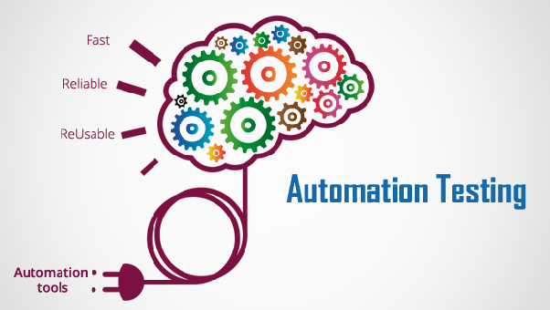
Automated Testing
Automated testing is the preferred option in the following areas/scenarios:
Regression Testing: Here, automated testing is suitable because of frequent code changes and the ability to run the regressions in a timely manner.
Load Testing: Automated testing is also the best way to complete the testing efficiently when it comes to load testing. Learn more about load testing with our best practices guide.
Repeated Execution: Testing which requires the repeated execution of a task is best automated.
Performance Testing: Similarly, testing which requires the simulation of thousands of concurrent users requires automation.

Slide 9
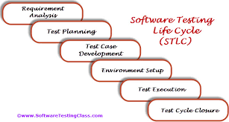
Software Testing Life Cycle
Software Testing Life Cycle (STLC) is defined as a sequence of activities conducted to perform Software Testing. It consists of series of activities carried out methodologically to help certify your software product.
A testing life cycle comprises of several phases and activities aligned in a sequential manner to initiate, execute and terminate the testing process.
A software testing process could be initiated as soon as the development process begins and may be carried out in parallel to the development activities.

Slide 10
Requirement Analysis
The very first phase of the software testing lifecycle involves the study and analysis of the available requirements and specifications.
Requirements could be either Functional (defining what the software must do) or Non Functional (defining system performance /security availability )
Activities | Responsibility | Outcome
Brainstorming sessions for the requirement analysis and feasibility. Identifying and sorting out the requirement priorities. Creating the requirement traceability matrix (RTM). Identifying the suitable test environment. Identifying the requirements acceptable for the automated testing and the manual testing. | QA team Project manager Test manager System architect Business analyst Client Major stakeholders | Testable Requirements. Requirement Traceability Matrix(RTM) Automation feasibility report (if applicable).

Slide 11
Test Planning
Once you have gathered a general idea of what needs to be tested, you ‘plan’ for the tests.
Basically, a strategy or strategies is/are defined and described for the testing process/activities.
Activities | Responsibility | Outcome
Scope and objectives are outlined. Deciding the testing types to be performed along with the specific strategy for each of them. Roles and Responsibilities are determined and assigned. Identifying the resources and testing tools required for the testing. Estimating the time and the efforts to carry out the testing activities. Defining and detailing the test environment. Defining the time schedules. Entry, exit criteria along with the suspension and resumption criteria is defined. Planning the training activity and sessions required by the testers(if any). Risk analysis is being done. Change management process is specified and described. | QA Manager or QA lead | Test Plan documentation Time and effort estimation documentation.

Slide 12
Test Case Development
Based on test plan and detailed requirements, test cases are designed and developed for the purpose of verifying and validating each and every requirements specified in the documentation.
Activities | Responsibility | Outcome
Test cases are designed, created, reviewed and approved. Relevant existing test cases are reviewed, updated and approved. Automation scripts (if any) are developed, reviewed and approved. Relevant test data are generated or imported from the development environment. Test conditions along with the input data and expect outcome for each test cases are defined and specified. | Generally, the testers have the job of writing the test cases under the supervision of QA lead or QA manager. However, the testers may be accompanied by the developers in generating the effective automation test scripts. | Test cases including automation scripts. Test Coverage Metrics. Test Data

Slide 13
Test Environment Setup
The software testing process needs an appropriate platform and environment encompassing the necessary and required hardware and software, to create and replicate the favorable conditions and intended environmental factors to perform actual testing activities i.e. execution of the developed test cases on the software.
Activities | Responsibility | Outcome
Test data is set up. Test environment checklist is prepared and the required hardware and software are aggregated. Test server is setup and network settings are configured. Test Environment management and maintenance process is defined and described. Smoke testing of the environment to check is readiness. Testers are being equipped with the bug reporting tools. | QA team under the supervision of QA manager sets up the test environment | Test Environment is set up and ready to execute tests. Smoke Test Results.

Slide 14
Test Execution
The test execution phase involves the execution of the developed test cases with the help of test data in the set up test environment.
Activities | Responsibility | Outcome
Test Cases execution as per the test plan. Comparison of actual results with the expected outcomes. Identifying and detecting defects. Logging the defects and reporting the identified bugs. Mapping defects with the test cases and accordingly updating the requirement traceability matrix. Re-testing, once a defect gets fixed or removed by the development team. Regression testing(if required). Tracking a defect to its closure. | Test Engineers are deployed to carry out the task of test case execution. | Test Status and results. Bug or Defect Report. Complete and updated Requirement Traceability Matrix (RTM).

Slide 15
Test Closure
The completion of the test execution phase and delivery of the software product marks the beginning of the test closure phase.
Apart from the test results, other testing related parameters are considered and reviewed such as quality achieved, test coverage, test metrics, project cost, adherence to deadlines, etc.
Activities | Responsibility | Outcome
Retrospection of the whole testing process. Test Life Cycle exist criteria is evaluated along with some other essential aspects such as test coverage, quality achieved, fulfilment of goals and objectives, critical business goals, etc. Need to change the exit criteria, test strategy, test cases, etc. are discussed. Test Results are analyzed and reviewed. All the test deliverables such as test plan, test strategy, test cases, etc. are collected and maintained. Test Closure Report and test metrics is prepared. Defects are arranged severity wise and priority wise. | QA lead or the QA Manager | Test Closure Report. Test Metrics. Learned process.

Slide 16

Defect Management
Defect management is a process to identify the defect of the software.
Defect management will work like a backbone to developing a team in finding the defect in the early stage in a very easy way.
Defect management works in the parallel way of software development process.
Software testing team finds all the bugs and defect and report to developing a team to fix it.
Defect management, records all the defect of the software these records can be seen later as well if you want to review or want to check that how you have fixed that.

Slide 17
Defect Management Process
Identification
Categorization
Prioritization
Assignment
Resolution
Verification
Closure
Management Reporting

Slide 18
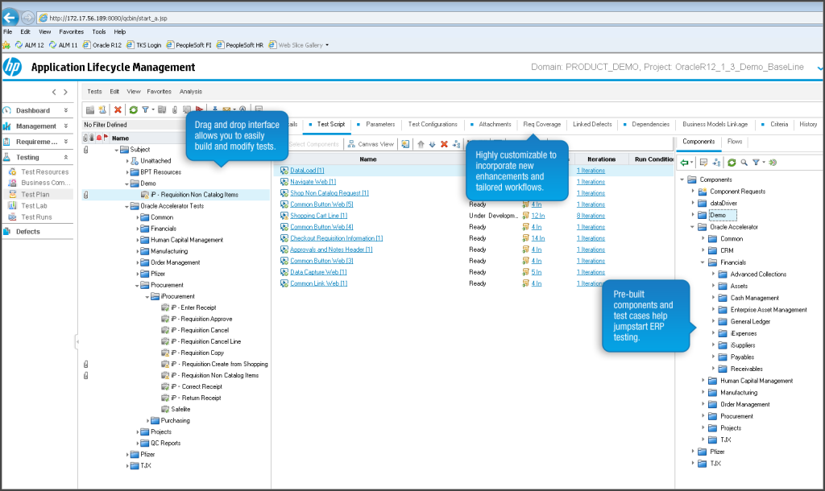

Slide 19
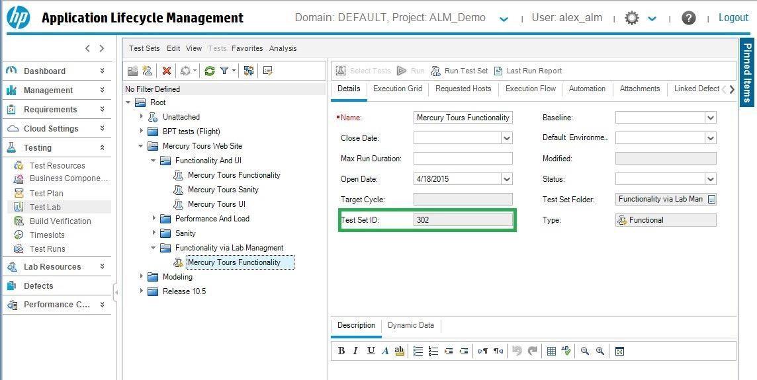
HP ALM

Slide 20
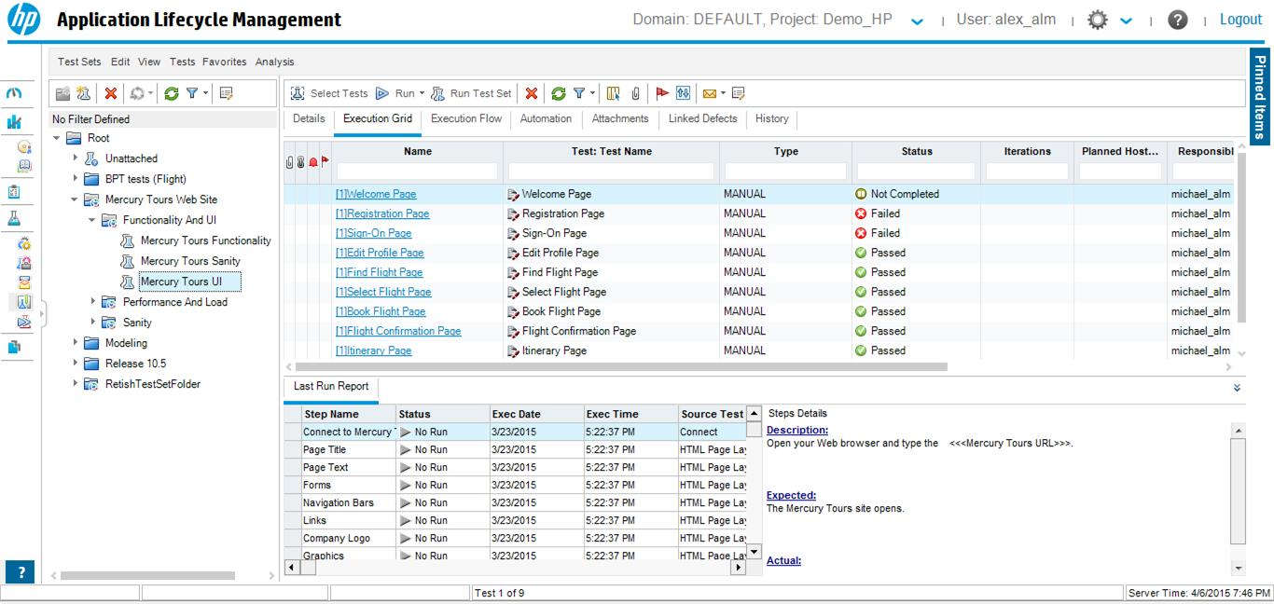
HP ALM

Slide 21
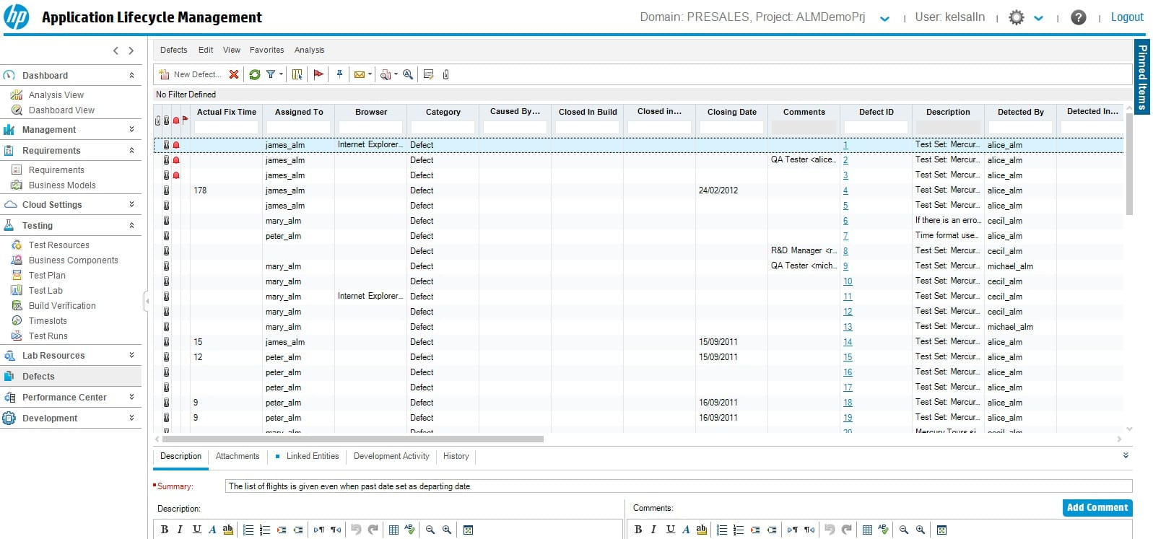
HP ALM

Slide 22


